Slide 1
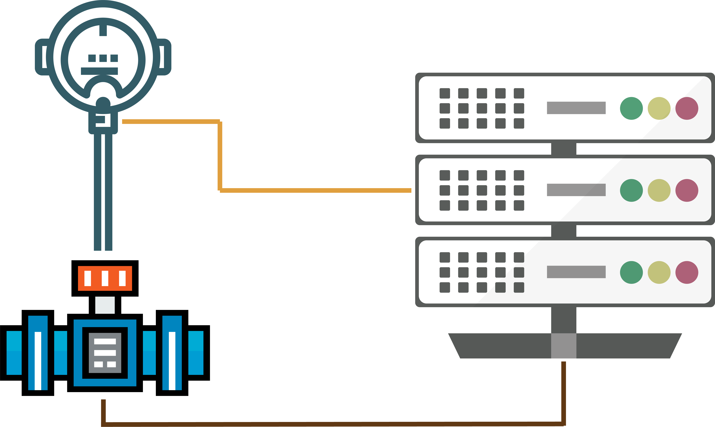
Loop Workflow

Slide 2
Agenda
Meeting Goal.
Loop Folder workflow.
Work Front.
Loop Process Digitalization.
Personas.
Case Scenario.

Slide 3
Presentation goal
Establish a commitment workflow process and dedicated key positions.

Slide 4
Loop Workflow

Slide 5



Loop workflow - Overview
QC Released
Folder Printed
Submit to QC
Folder Ready
Submit to Support Team
Submit to Pre-Comm
Loop Done
Final Approval
Auto
Auto
Auto
Auto
QC
QC
Pre-Comm
Release
Folding
Perform
QC Released: TR QC has verified and released all RFI required for one loop folder.
Folder Printed: ILD, Required RFI to be released for items related to the loop as per TR QC, P&ID and index sheet are printed and dossier in a folder.
Submit to QC: Folder handed over from Support Team to QC.
Folder Ready: Index sheet has been signed.
Submit to Support Team: Folder handed over to Support Team.
Submit to Pre-comm: Folder handed over to Pre-Comm Team.
Loop Done: Loop successfully performed.
Final Approval: Client Approved the folder, folder to be archived and responsibility goes to client.

Slide 6



Loop workflow - Detailed
Index Signed
Final Approval
Print Folder
Client/Mangt
QC
Issued ILD
Released
Pre-Comm Phase
Construction Phase
1
2
QC Coordinator
Engineering
QC Coordinator
Issued for cons./Red Line
Raise RFI
Construction (Subcontractor)
Submit
Done
Pre-Comm

Slide 7
Work Front

Slide 8


Loop Performed work front
Pre-Comm
Planning
Change
Create priority for the loop folder as per Subsystem handover dates
Report missing ILD
Engineering
Loops System
Inform
Released
Subcontractor
Construction
QC Coordinator

Slide 9
Blockage Control

Slide 10
Blockage management
Folding
Release
Perform
Blockage management allow participant to register any constraint for the loop with integration with Notification center, so it is automatically notifying the responsible with the issue. And gives transparency to all why this loop is not performed.
Not only tracking but also gives the team a lesson learn for upcoming same loop in a different area to avoid the same blockage in advanced.
Notify by Mail
Subcontractor
Construction
Register an Issue
Blockage Control and Notification Center
Engineering
QC Coordinator

Slide 11
Personas

Slide 12
Loop workflow Key person
Folder Printed: QC.
Folder Released: TR QC Team.
Folder Ready: QC Coordinator.
Loop Done: Pre commissioning team.
Final Approved: QC Coordinator.

Slide 13
Loop War Room

Slide 14

Loop War Room
It is an event kicks off the Loop performed. The purpose of War Room is to define what can be performed in the next week and how that work will be achieved.
War Room is done in collaboration with the whole Key Persons.
How is it done?
During the War Room meeting, the Pre commissioning Owner describes the highest priority Loops to be performed. After pending items related to those loops are defined using (EICA Loop Map).
Then, War Room works in one of two general ways: by considering a team's historical velocity or by considering a team's capacity. Also, Blockages and constraint is to be discussed if it has not been resolved for more than 2 weeks.
Priority Order
Select Pending Items
Remove Site conditions
Released
Construction Workfront
New Blockage
Loops Backlog

Slide 15
Loop Process Digitalization

Slide 16
Loop workflow digitalization
Goal: Perform successfully loop checks fast and smooth.
Mission: Collaboration over Negotiation.
Features:
Single source of truth for all required information.
Register Loop workflow steps.
Blockage management system.
Notification Center.
QR code and cloudification.
Easy Workfront.
Integration with Production Control App.

Slide 17
Thank you!

